Slide 1
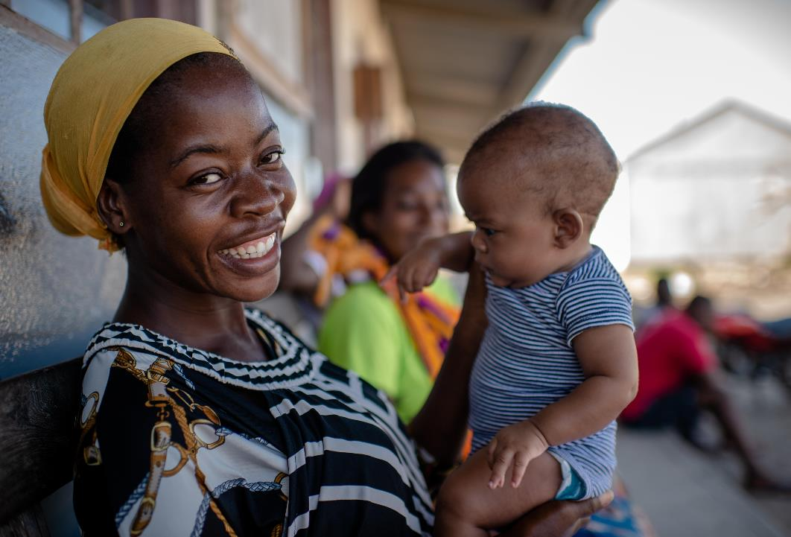


Safeguarding children and young people participating in events
SOS Children’s Villages
© Cornel van Heerden | Mozambique

Slide 2
Safeguarding children and young people participating in events SOS Children’s Villages
Presenters
Jan Folda
Team leader Child, Youth and Adult Safeguarding
SOS Children’s Villages International
Marie Mosan Sarr
National Child and Youth Safeguarding Coordinator
SOS Children’s Villages in the Gambia
Edward Camasis
Program Officer for Youth Development and YouthCan!
SOS Children’s Villages Philippines

Slide 3
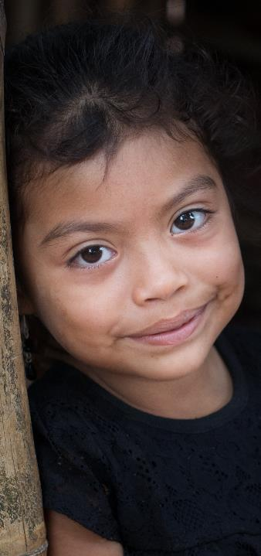

Agenda
01
Child and youth safeguarding at SOS Children’s Villages International
02
Safeguarding children and young people participating in events. Policy requirements, important considerations.
03
Practical experience of SOS Children’s Villages the Gambia
© Alejandra Kaiser | Guatemala
04
Practical experience of SOS Children’s Villages Philippines
3

Slide 4
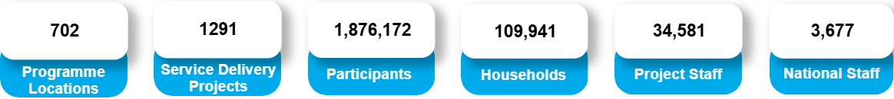
Child and youth safeguarding at SOS Children’s Villages International
SOS Children’s Villages International is a federation of legally independent, autonomous member organisations, operating in 137 countries and territories.
* Annual statistics for 2024

Slide 5
Child and youth safeguarding at SOS Children’s Villages International
Child and youth safeguarding work of the federation and individual member organisations is guided by federation binding policies and regulations.
Child and Youth Safeguarding Policy (endorsed in 2023)
Child and Youth Safeguarding Regulation (2023), providing further clarification of the Policy
Code of Conduct (2023)
Misconduct Incident Management Regulation (2023)
Misconduct Investigation Regulation (2023)
In addition, there are non-binding documents, providing further guidance to the member associations on specific topics

Slide 6
Child and youth safeguarding at SOS Children’s Villages International
SOS Children’s Villages operates various programmes, including alternative care, youth care, family strengthening, education, health, and emergency response.
Child and youth safeguarding policies and regulations apply not only to the programme work of the member organisations, but also to all other areas of their work (e.g. human resources, fundraising, communications, etc.).
The child and youth safeguarding work of the organisation is based on four key pillars:
Prevention
Raising awareness and capacity building
Reporting
Responding.
Each member organisation is required to appoint a national focal person responsible for coordinating, supporting and coordinating safeguarding activities.

Slide 7
Safeguarding children and young people participating in events. Policy requirements, important considerations.
A thorough safeguarding risk assessment must be carried out for each new project and activity.
This takes into account both internal and external risk factors.
The assessment is organised by the member organisation or a specific programme location.
The views and thoughts of the children and young people concerned must be considered.
The results of the risk assessment must be documented, and all identified risks must be addressed with appropriate risk mitigation actions.
It must be clear who is responsible for the specific actions and what the expected outcomes are.

Slide 8
Safeguarding children and young people participating in events. Policy requirements, important considerations.
In the case of internal and external events, the risk assessment must consider factors such as:
The organiser of the event
Do the children and young people need to travel to the event?
If so, how will the trip be organised, and who will accompany them?
Will they be staying overnight, or is it a one-day activity?
How will their participation be organised?
Will there be someone to support them throughout the event?
Are there any specific issues requiring further consideration, such as age-related matters, language or other specific needs of the children?
Is it clear how to report potential concerns during the event, and to whom?
All actions must be guided by the best interests of children and young people. This cannot be compromised for the sake of the success of the event.

Slide 9
Best practices for safeguarding children and young people at external events in The Gambia
Marie Mosan Sarr
National Child and Youth Safeguarding Coordinator
SOS Children’s Villages in the Gambia

Slide 10
Introduction
Participants in SOS Gambia take part in various youth activities, including YouthCan! Pitching Competitions, YouthCan! Youth Congress and the National Youth Forum this year (2025)
Safeguarding children and young people during these events is a critical responsibility that requires attention to detail, thorough preparation, and effective communication.
In The Gambia, safeguarding priorities are integrated into all activities, and the team works closely with the staff organising these events.
Ultimately, protecting and empowering children and young people during these experiences is a shared responsibility.

Slide 11
Overview of best practices
Risk assessment to ensure a safe environment
Before the event, the safeguarding team conducts a risk assessment in collaboration with the event organisers from SOS Children’s Villages.
The aim is to identify potential risks and implement strategies to mitigate them.
This ensures that the identified venues are safe and suitable for children and young people.

Slide 12
Overview of best practices
Outline clear safety procedures
The development of comprehensive safeguarding standards that outline safety procedures for all participants, staff and volunteers, ensuring that everyone is informed of these guidelines. These are created on a case-by-case basis depending on the type of event.
Additionally, the team creates detailed emergency measures, including first aid and evacuation plans, which are tailored to the specific environment.
Regular reviews and exercises are conducted to enhance preparedness and confidence among all individuals involved.

Slide 13
Overview of best practices
Encouraging quality supervision and monitoring
Appropriate adult-to-child ratios must be maintained for any external activities organised for children and young people.
Additionally, designated safeguarding focal persons should be appointed among the young participants and staff to oversee the activities.

Slide 14
Overview of best practices
Communication with parents and guardians (consent)
At the National Association, open communication and respect are at the heart of what we do. It is essential to obtain consent before involving any participant in external activities.
The comfort and agreement of parents and guardians is paramount.
We encourage open communication regarding any concerns.

Slide 15
Overview of best practices
Report concerns
Clear protocols for reporting safeguarding concerns should be established, and staff should be oriented on how to respond appropriately to disclosures or suspicions of abuse during the event.

Slide 16



Safeguarding Children and Young People at Events: Best Practices of SOS Children's Villages Philippines
Edward Camasis
Programe Officer for Youth Development and YouthCan!
SOS Children’s Villages Philippines
1

Slide 17




Child Participation Planning
How We Plan for Safe and Meaningful Involvement
02
03
04
Brief all facilitators, volunteers, and partners on Code of Conduct and Do No Harm principles.
Prepare children through orientation sessions to understand their rights, roles, and boundaries.
Conduct pre-event safeguarding risk assessment.
Parental and caregiver consent secured for each participant.
Assign Child Safeguarding Focal Persons (CSFPs) during events.
Notes:
Example: During the YouthCan! Conference and Allianz Ride Safe activities, safety briefings and consent forms were mandatory before participation.

Slide 18







Principles and Practices (Before & During the Event)
Data Privacy- Images or videos of participants are only taken with informed consent from the child/young person and their legal guardian. We always consult the child first and explain the purpose clearly.
03
Food and Health Safety- We conduct pre-event surveys on food restrictions and allergies to ensure safe meal planning.
02
04
Voluntary Participation- All activities are voluntary, not coercive — participants may decline any activity without prejudice or consequence.
Health Preparedness- First aid kits and basic medicines are always available at every venue for immediate response to minor incidents.
Transparency and Information Sharing- Open discussions are encouraged to ensure participants fully understand the purpose, process, and expectations of the activity.
Age-Appropriate Modules- Activity content and modules are tailored to the age and developmental level of participants.
Child-Friendly Communication- We use friendly, inclusive language and local dialects to ensure comfort, understanding, and participation.
Notes:
Example: During the YouthCan! Conference and Allianz Ride Safe activities, safety briefings and consent forms were mandatory before participation.

Slide 19
Risk Mitigation Measures
Creating a Safe Environment
01
Participant–staff ratios are monitored to ensure adequate supervision.
02
Separate accommodation and sanitation facilities for boys and girls.
03
Emergency protocols (health, transport, contact tracing, etc.) are in place.
04
Partner vetting – all external facilitators and organizations undergo safeguarding screening.
05
Monitoring team ensures child-friendly spaces throughout the event.
19

Slide 20
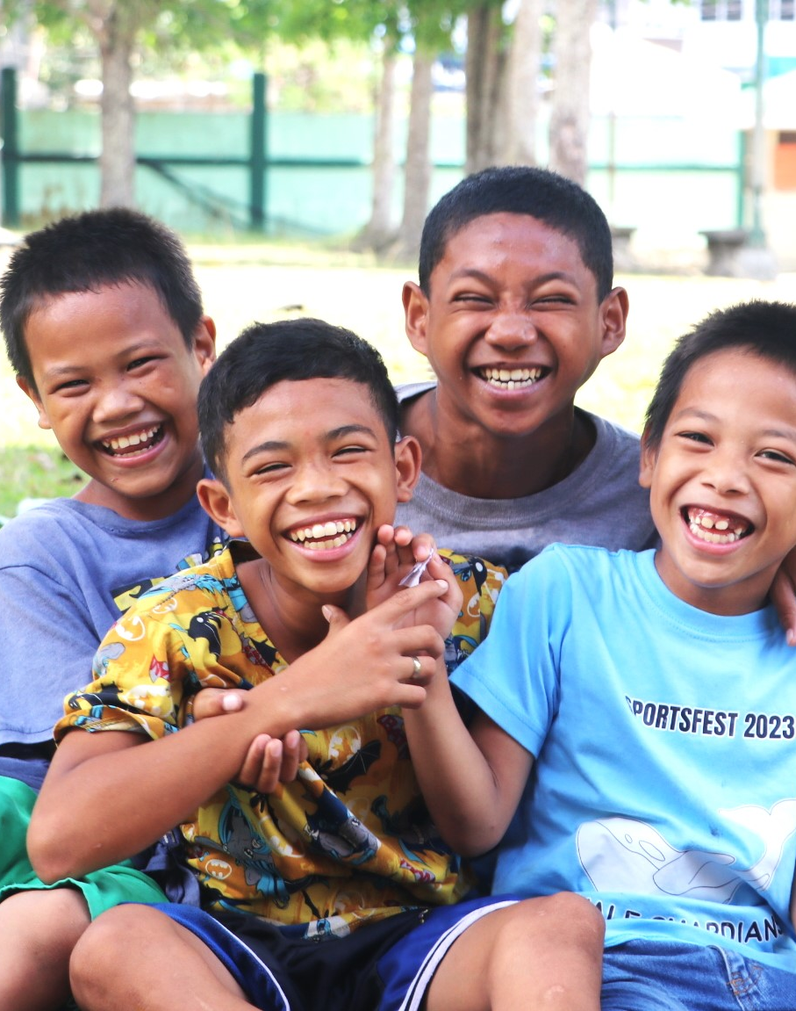

Reporting and Response Mechanisms
Empowering Children to Speak Up
Pre-event sessions inform children of how and where to report concerns.
Accessible child-friendly reporting channels:
On-site focal person per CV locations
OMBUDS
24/7 national Child & Youth Safeguarding Hotline
Reports are documented and managed in line with NIMT and MA Safeguarding protocols.
© Kristin Svorte | Vietnam
20

Slide 21
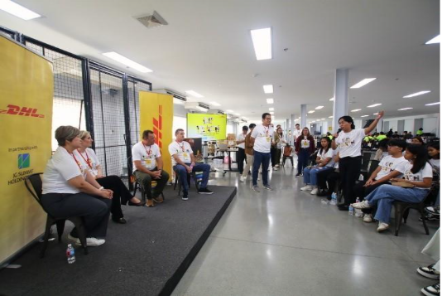
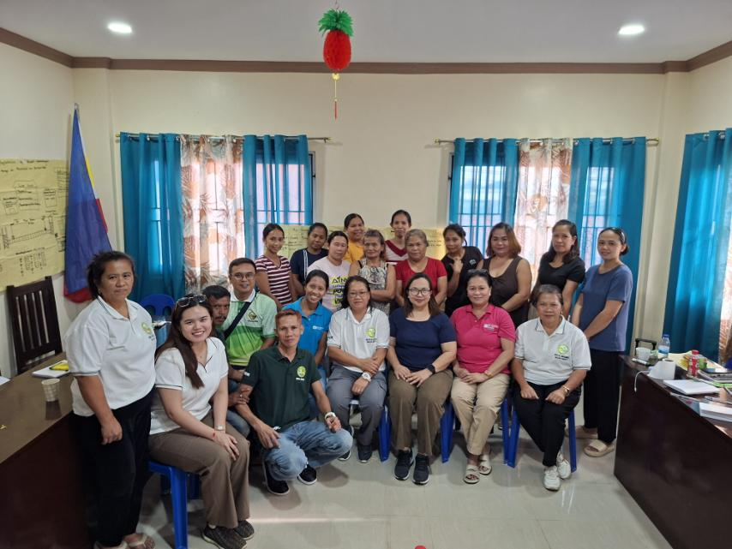
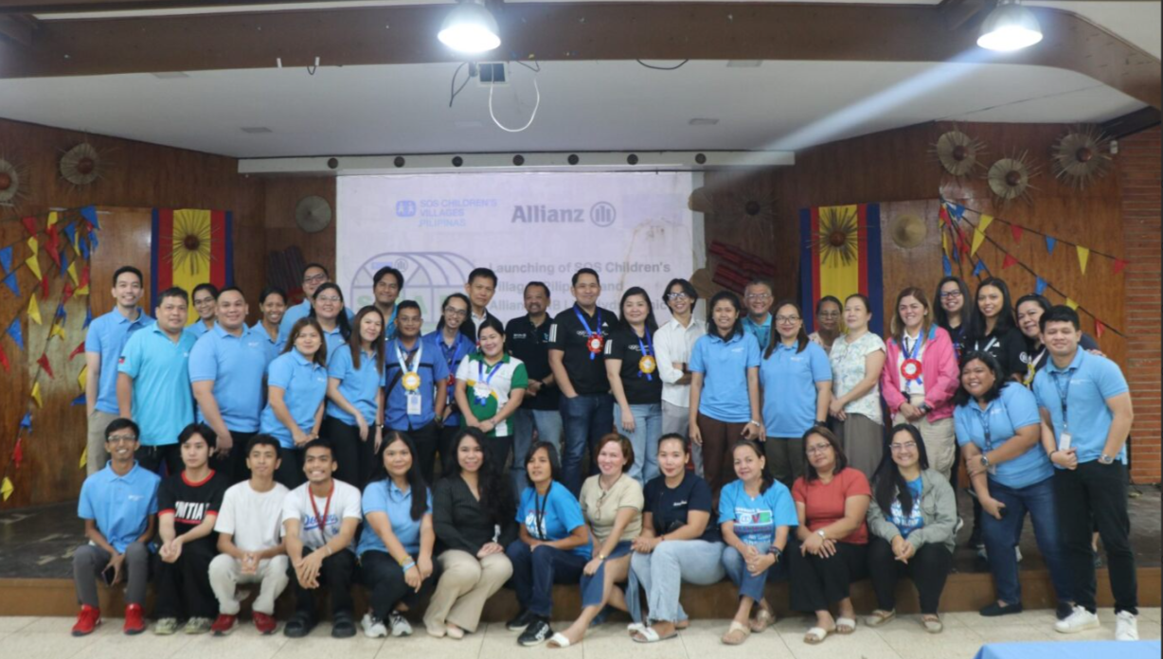
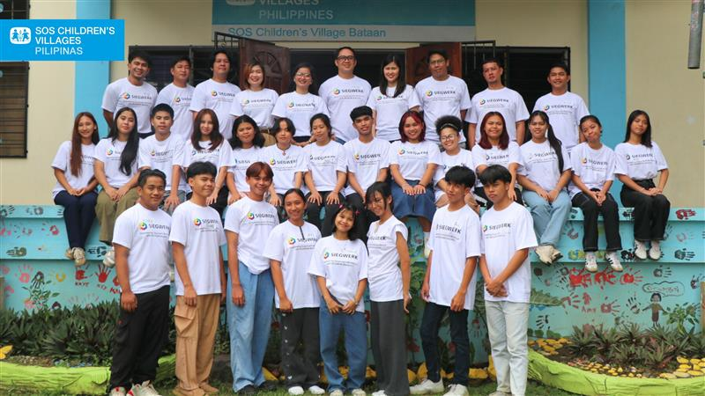
Inclusion of Non-SOS Participants
Managing External Engagements
YouthCan! Work-place visit at DHL warehouse in Calamba Laguna Philippines
Community in Tacloban with Programs Team Philippines
Allianz PNB Life Launching of SHAPE Hydroponic “Greenhouse”
Yes, SOS Philippines also includes children not under SOS care in events (e.g. FSP youth, partners’ programs).
For SOS-hosted events: our safeguarding standards are fully applied to all participants.
For external events:
- We ensure MOUs or partnership agreements specify safeguarding responsibilities.
- A Safeguarding Checklist is completed before SOS youth attend.
- Staff accompany youth to monitor well-being.
YouthCan! Conference with SIEGWERK Employees Engagement at CV Bataan, Philippines
Notes:
#1C325D

Slide 22
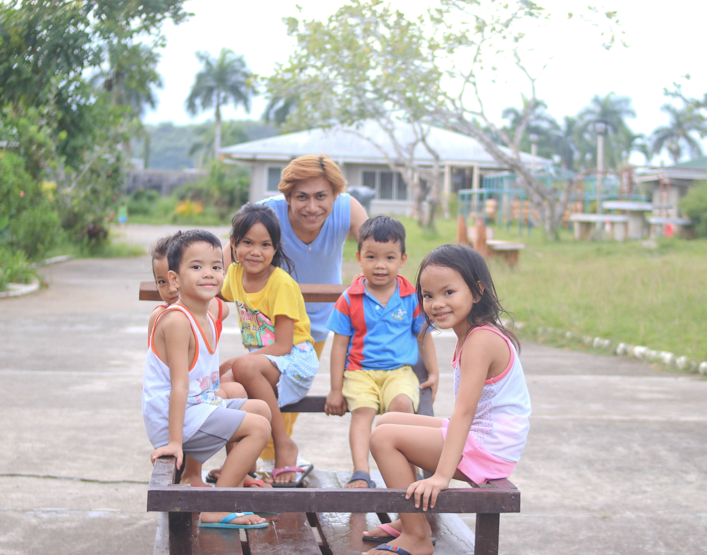

Our Commitment
Children’s safety is non-negotiable in all activities.
Safeguarding is everyone’s responsibility — from planning to post-event evaluation.
Continuous learning, risk review, and feedback strengthen our safeguarding culture.
“Safe participation leads to empowered voices.”

Slide 23


Questions or comments?

